Slide 1
Credict Score Classification
-- Using ML model

Slide 2
Table of contents
01
02
03
04
Context of the project
Analysis of the data
Demo to predict
QAs

Slide 3

01
Context of the Project

Slide 4
About the project
Credict score
Object
Credit scoring is an important indicator for financial institutions to assess the credit risk of customers, which directly affects loan approval and interest rate determination.
By building accurate credit score classification models, financial institutions can manage risks more effectively and optimize the decision-making process.
Classifying credit scores using machine learning techniques.
Given a person’s credit-related information, build a machine learning model that can classify the credit score.

Slide 5
- Data used
- Data discription
The dataset contains several features covering aspects of customers' personal information, financial status, and credit behavior.
- Numerical data [‘age,interest_rate’,’credit_utilization_ratio’,’annual_income’,’monthly_in_hand_salary’]
- Categorical data
['id', 'customer_id', 'month', 'name', 'ssn', 'occupation','type_of_loan', 'credit_mix', 'payment_of_min_amount','payment_behaviour']
“Credit Score Classification Cleaned Dataset“ -- Kaggle
- Data size
(96696, 50)

Slide 6
02
Data Analysis

Slide 7
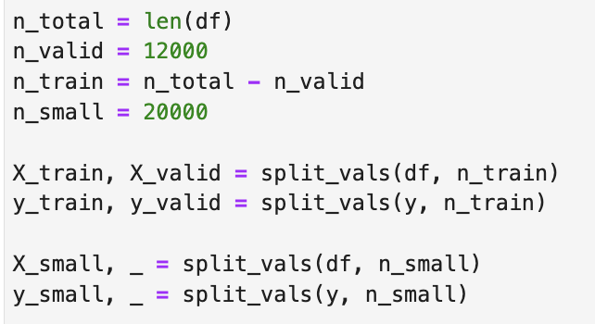
Data Preprocessing
1 Load and preview data
Clean the data
Read csv
Display all the data
Fill NA
Remove repeat data
Process data
Split data sets
-Find out the 'Object' variable
-Drop irrelevant variables :
#id & #customer_id & #name & #ssn & #type_of_loan
-Convert strings into numerotated categories :
#month & #occupation &
#credit_mix etc.
Divide the data
Train set / Valid set / Samll train set

Slide 8
ML Model ---- CatBoostClassifier
Model Used :
CatBoost is a machine learning model based on gradient boosting that specializes in handling categorical variables and high-dimensional data.
Why CatBoost? :
- Automatic handling of category variables: no additional coding is required and category data can be used directly.
- Excellent performance: performs well for handling unbalanced data and complex features in multi-categorization tasks.
- Fast training: optimized algorithms
- Less parameter tuning: less reliance on parameter selection, easier to use compared to other models.

Slide 9
Parameter Tuning Steps:
Phase | Objective | Key Actions
1. Initial Mode | Quickly test performance | Use default parameters and train quickly
2. Adjust Tree Count and Learning Rate | Balance training speed and accuracy | Use high learning rate for faster training, low learning rate for stability
3. Grid Search Tuning | Systematically find optimal parameter combinations | Use GridSearchCV to explore multiple parameter settings
4. Validation Set Evaluation | Prevent overfitting and monitor performance in real-time | Set eval_set and plot learning curves
5. Feature Importance Analysis | Identify key features and reduce feature dimensions | Use get_feature_importance to evaluate feature significance

Slide 10
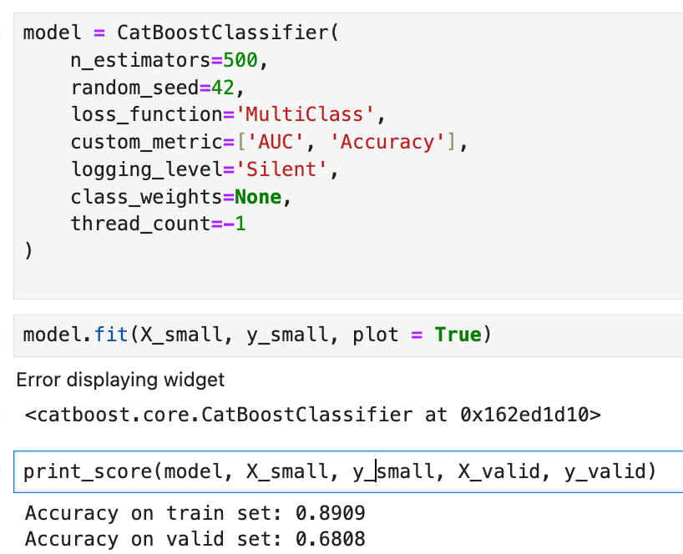
Initial Mode
Basic Catboost

Slide 11
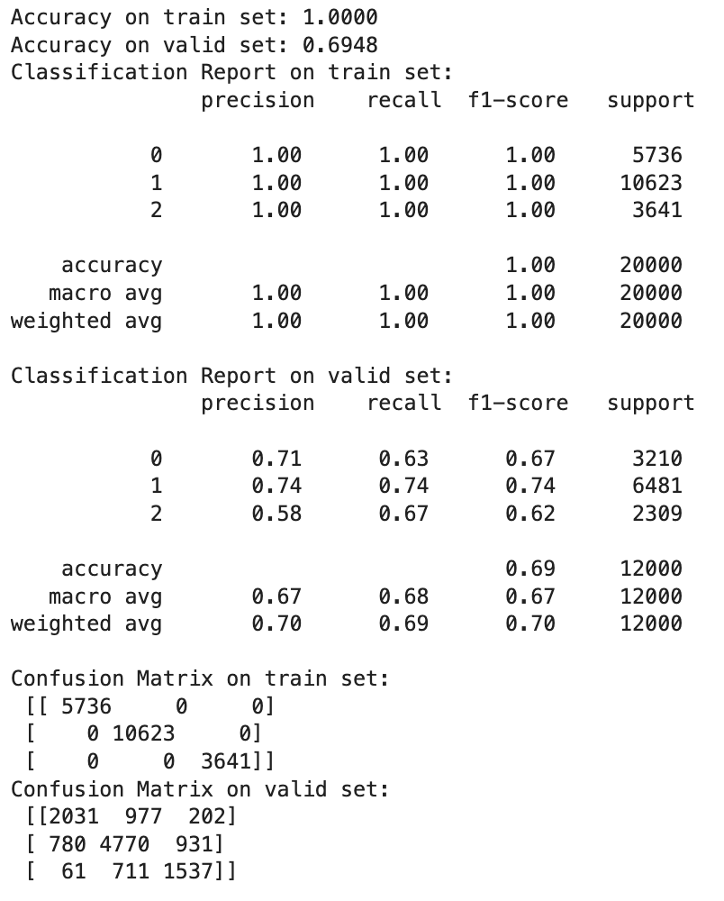
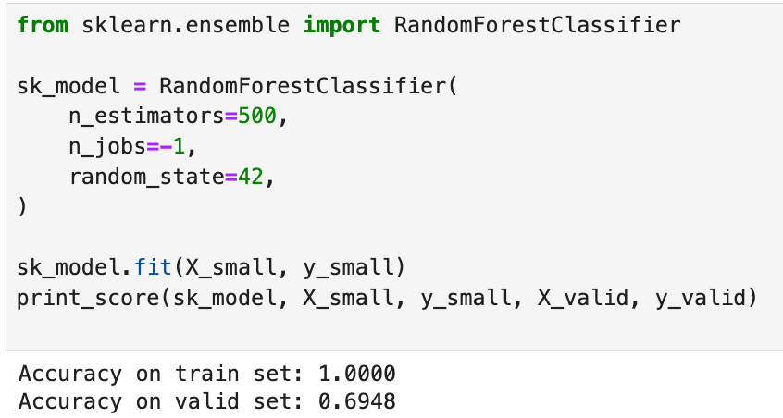
Random Forest
Comparing the performance metrics (e.g., accuracy and AUC) of Random Forest and CatBoost

Slide 12
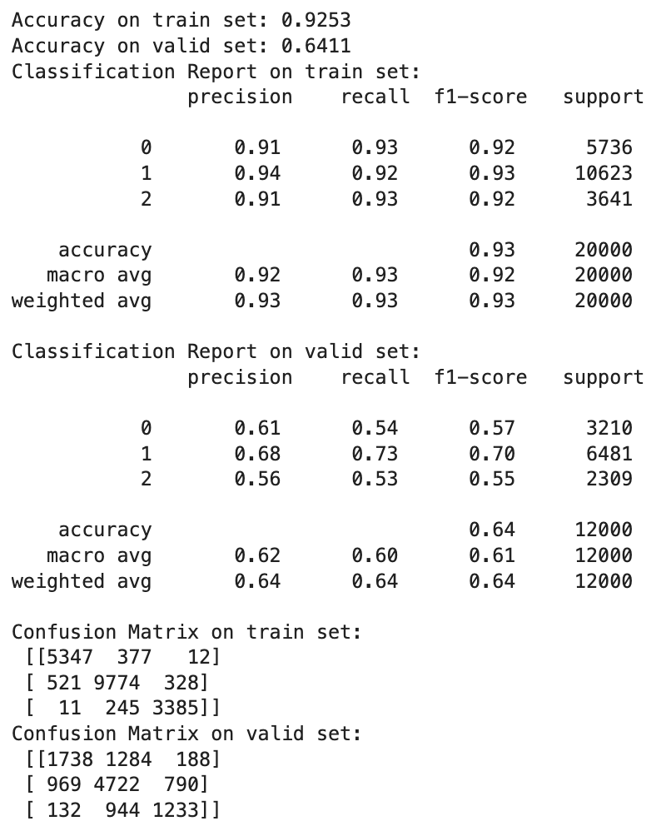
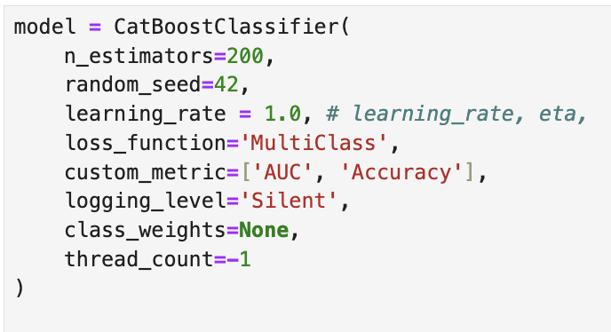
Learning Rate
rate = 0.005 & 1
Check for overfitting (usually high learning rates cause the model to fit the training set quickly)

Slide 13
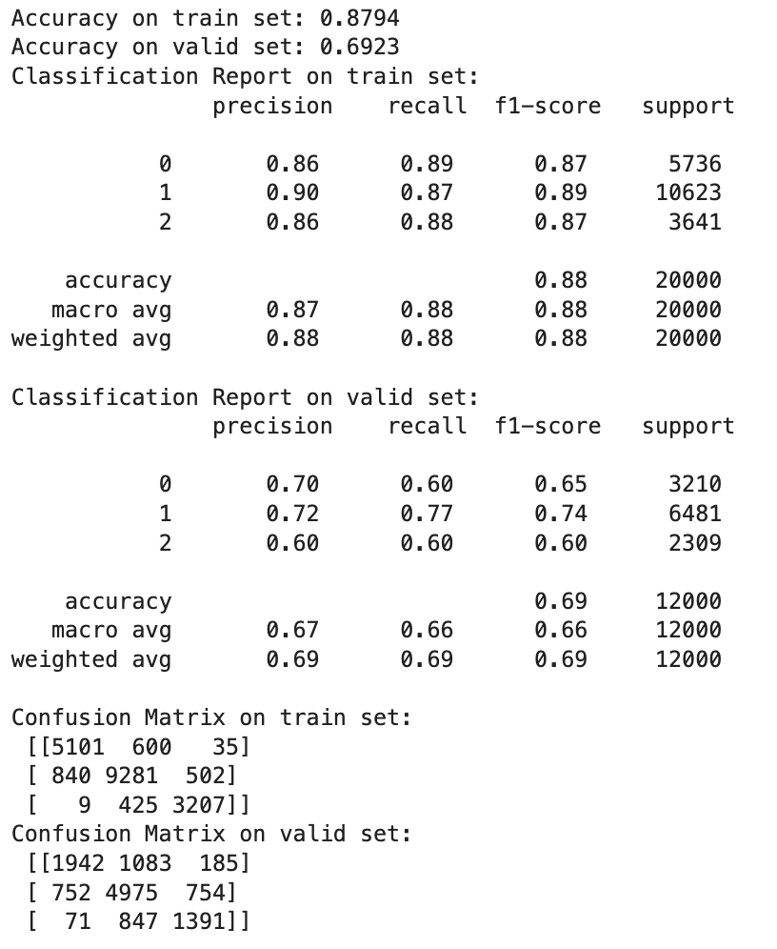
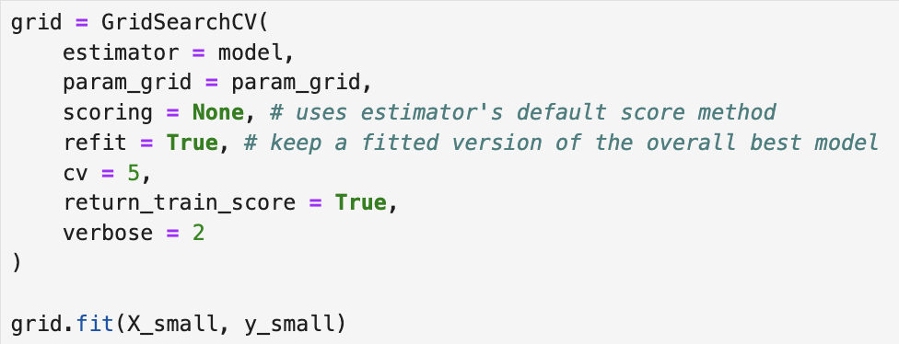
Grid Search Tuning
Using GridSearchCV and the grid search
Retrain the model using the feature filtered training set X_train_keep, y_train

Slide 14
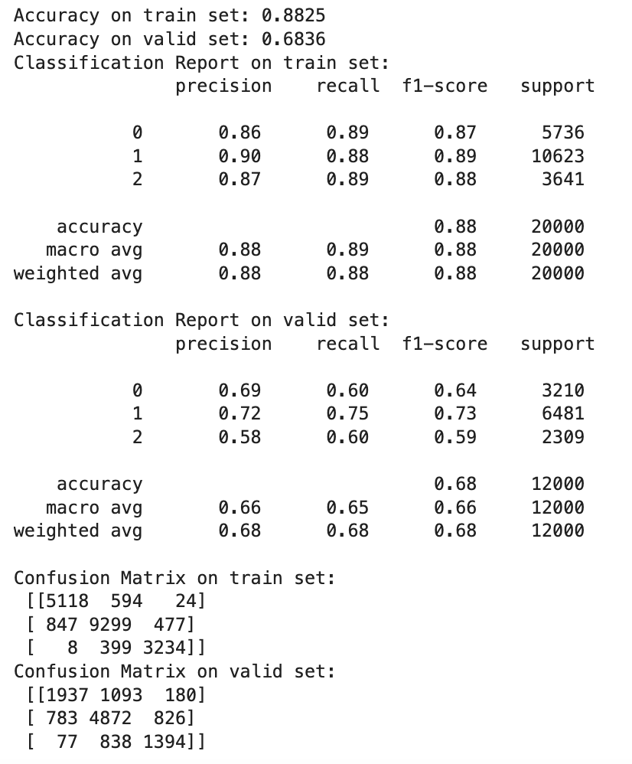
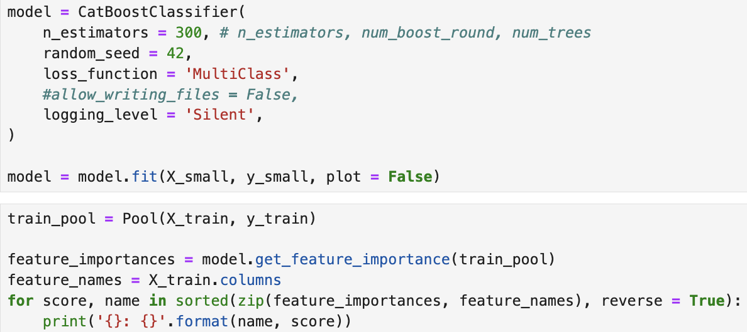
Feature Importance Analysis
Choose i > 0.005
Than drop others

Slide 15
Model Evaluation
Validation set accuracy:
GridSearchCV Catboost(0.6923)
High learning rateCatBoost (0.6836)
Random Forest (0.68 ).
Training set accuracy:
High learning rate CatBoost(0.8825)
GridSearchCV Catboost (0.8794)
Random Forest (0.85)
AUC:
GridSearchCV closest to 1
Accuracy_score
Measures the overall accuracy of the prediction.
AUC
Measures classification ability, especially for unbalanced data.
Classification Report
Includes Precision, Recall, F1 score, etc.
Confusion_matrix
Used to analyze specific classification errors

Slide 16

03
Demo

Slide 17
Thanks!
Do you have any questions?
Please keep this slide for attribution

